Slide 1
e!COCKPIT
Fundamentals

Slide 2


General for controlling the WAGO-I/O-SYSTEM
1
History
IEC 61131
Programming system
Application
Notes:
3
4
5
6
2
1
Contents
General WAGO-I/O-SYSTEM
Hardware
Software
Programming
Data types & variables
Appendix

Slide 3
Notes:
1
2
3
4
5
6

Slide 4
History
Programmable Logic Controllers
1965 … 70 In the US, the automotive industry encouraged the development of a new type of control for converting transfer lines
(PLC-Programmable Logic Controllers)
Beginning in 1974 These controllers have been used in Germany as well
(PLC - Programmable Logic Controller)
1983 DIN 19239
1993 DIN IEC 61131-3
Today Large selection of manufacturers. IEC 61131 contains definitions of requirements for modern PLC systems in order to counteract language elements and provide a uniform program structure independent of programming systems.

Slide 5
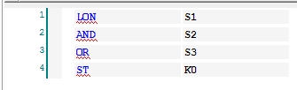

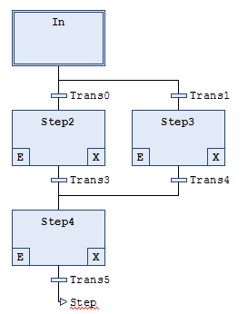
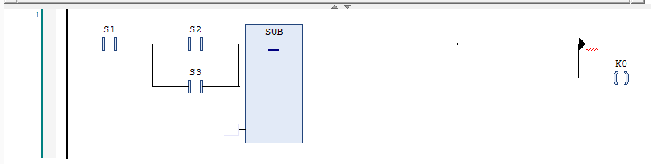
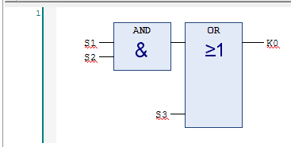
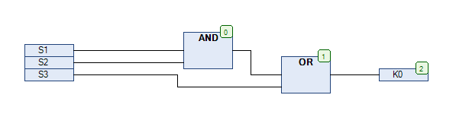
IEC 61131-3 − The languages
IL (Instruction List)
ST (Structured Text)
SFC (Sequential Function Chart)
Ladder Logic Diagram (LD)
FBD (Function Block Diagram)
CFC (Continuous Function Chart)

Slide 6
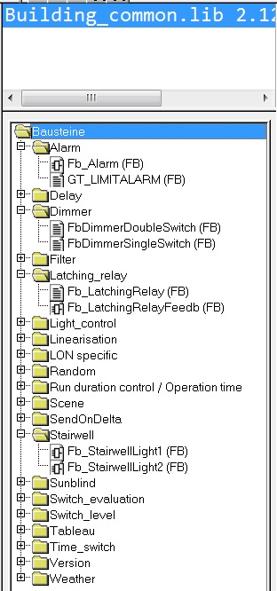
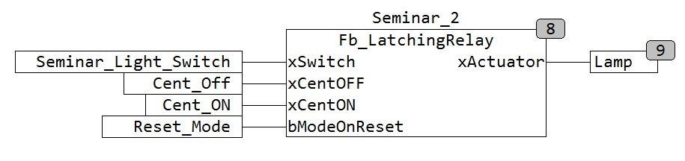
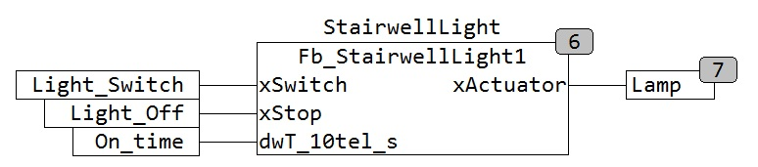
Configuration instead of programming
Software libraries
Program: Light_Seminar_2
Program: Light_Stairwell
Notes:
There are a number of libraries in different areas, the various components which are already finished.

Slide 7
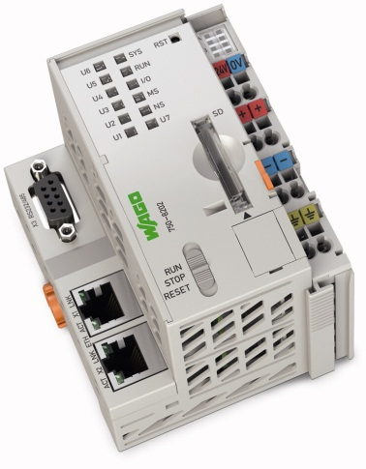
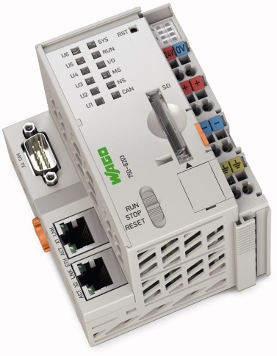
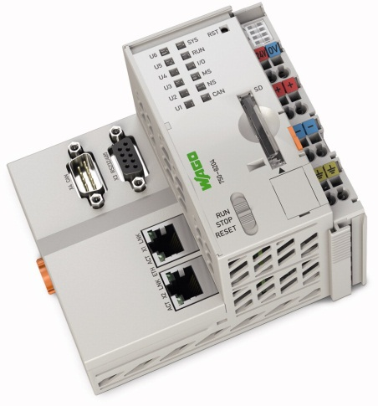
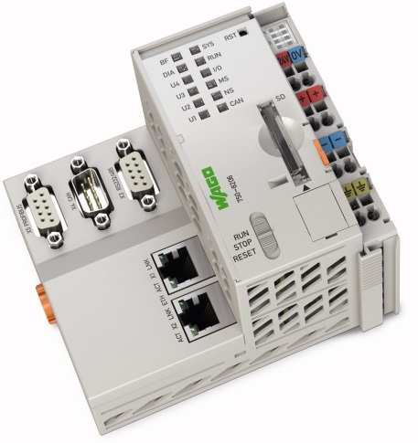
Controllers
e!COCKPIT currently supports the following controllers
PFC200 750-8202
PFC200 750-8203
PFC200 750-8204
PFC200 750-8206
Programming according to IEC 61131-3

Slide 8
PLC cycle
Time reaction – PLC cycle
READ
WRITE
The time of one PLC cycle depends on the CPU and the length of the program.
I
O
DATA Processing
CYCLE TIME
Notes:
Like most PLCs, a WAGO controller also functions using the IPO principle. It has an input part, a processing part, and an output part.
The data from connected sensors and actuators are connected to the controller using Input/output devices.
The controller functions cyclically: It reads the values of all the inputs at the beginning of a cycle (“read process image” is also used in conjunction with this).
Afterwards, all program instructions are (sequentially) processed and the assigned outputs are written at the end of the cycle into the output components.
To optimize processing, reading and writing the process data is carried out in one step at the beginning of the cycle.

Slide 9
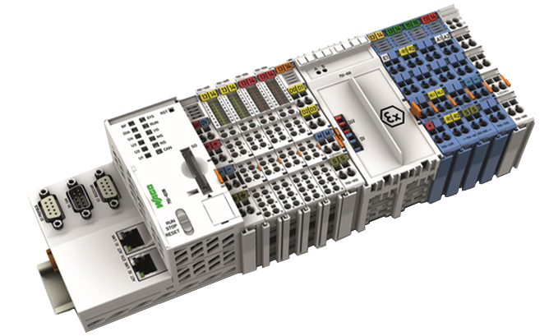

Application
Stand alone vs. networked controllers
PLC can control autonomous units
Thanks to the networking features many PLC can be connected to create larger systems
Notes:
As a system partner, WAGO solves all automation tasks using centralized and decentralized control architecture in all sectors of industrial, process, and building automation.
The IEC 61131 programming standard is thus an important guideline for modular automation components.
Integrated Web pages and Web-based visualization provide IT applications with real-time process data.
Both large memory and an integrated multitasking system readily meet stringent automation requirements.
A large number of library functions support both software/hardware interfaces and integrated file system.

Slide 10
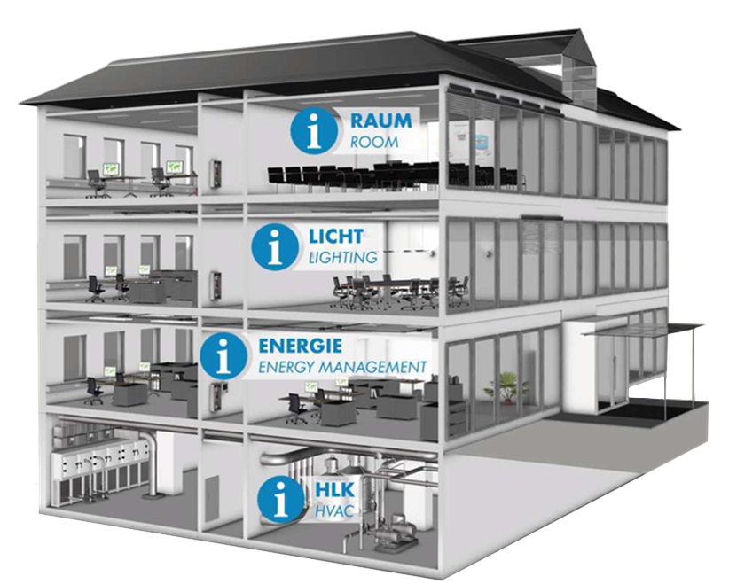
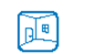


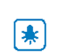

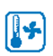
Application
Decentralized intelligence with networked controllers

